Slide 1
CHAPTER 1
SCSI1013: Discrete Structures
SET THEORY
[Part 2: Operation on Set]
2017/2018 – Sem. 1

Slide 2
Union
The union of two sets A and B, denoted by A ∪ B, is defined to be the set
A ∪ B = { x | x ∈ A or x ∈ B}
The union consists of all elements belonging to either A or B (or both)

Slide 3
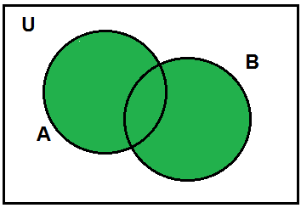
Union
Venn diagram of A ∪ B

Slide 4
Example
A={1, 2, 3, 4, 5}, B={2, 4, 6} and C={8, 9}
A ∪ B = {1, 2, 3, 4, 5, 6}
A ∪ C = {1, 2, 3, 4, 5, 8, 9}
B ∪ C = {2, 4, 6, 8, 9}
A ∪ B ∪ C = {1, 2, 3, 4, 5, 6, 8, 9}

Slide 5
Union
If A and B are finite sets, the cardinality of
A ∪ B,
| A ∪ B| = |A| + |B| − |A ∩ B|

Slide 6
Intersection
The intersection of two sets A and B, denoted by A ∩ B, is defined to be the set
A ∩ B = { x | x ∈ A and x ∈ B}
The intersection consists of all elements belonging to both A and B.

Slide 7
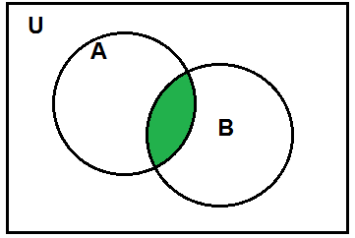
Intersection
Venn diagram of A ∩ B

Slide 8
Example
A={1, 2, 3, 4, 5, 6}, B={2, 4, 6, 8, 10} and
C={ 1, 2, 8, 10 }
A ∩ B = {2, 4, 6}
A ∩ C = {1, 2}
C ∩ B = {2, 8, 10}
A ∩ B ∩ C = {2}

Slide 9
Disjoint
Two sets A and B are said to be disjoint if,
A ∩ B = ∅

Slide 10
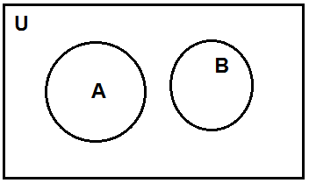
Disjoint
Operations on Sets
Venn diagram, A ∩ B = ∅

Slide 11
Example
A = {1, 3, 5, 7, 9, 11}
B = {2, 4, 6, 8, 10}
A ∩ B = ∅

Slide 12
Difference
The set
A−B= {x | x ∈ A and x ∉ B}
is called the difference.
The difference A− B consists of all elements in A that are not in B.

Slide 13
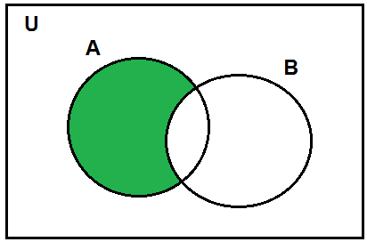
Difference
Venn diagram of A−B

Slide 14
Example
A= { 1, 2, 3, 4, 5, 6, 7, 8 }
B= { 2, 4, 6, 8 }
A−B = { 1, 3, 5, 7 }

Slide 15
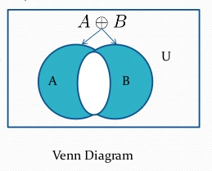
Symmetric Difference
The symmetric difference of set A and set B, denoted by A ⊕ B is the set (A - B) U (B - A)

Slide 16
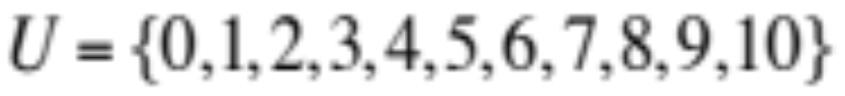
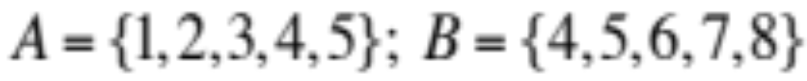

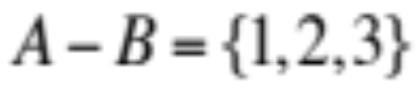
Example

Slide 17
Complement
The complement of a set A with respect to a universal set U, denoted by A′ is defined to be
A′ = {x ∈U| x ∉ A}
A′ = U−A

Slide 18
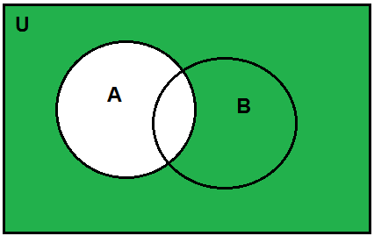
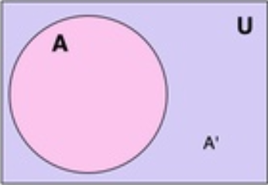
Complement
Venn diagram of A’

Slide 19
Example
Let U be a universal set,
U= { 1, 2, 3, 4, 5, 6, 7 }
A= { 2, 4, 6 }
A′ = U – A = { 1, 3, 5, 7 }

Slide 20
Exercise
Let,
U = { a, b, c, d, e, f , g, h, i, j, k, l, m }
A = { a, c, f, m}
B = { b, c, g, h, m }
Find:
A ∪ B , A ∩ B , | A ∪ B| , A − B dan A′.

Slide 21

Exercise
Let the universe be the set U={1, 2, 3, 4,…..,10}.
Let A={1, 4, 7, 10}, B={1, 2, 3, 4, 5} and
C={2, 4, 6, 8}.
List the elements of each set:
U′
B′∩ (C−A)
B − A
(A∪B) (C − B)

Slide 22
Set Identities
(or Properties of Set)
Commutative laws
A ∩ B=B ∩ A
A ∪ B=B ∪ A

Slide 23
Set Identities (cont’d)
Associative laws
A ∩ (B ∩ C) = (A ∩ B) ∩ C
A ∪ (B ∪ C) = (A ∪ B) ∪ C

Slide 24
Set Identities (cont’d)
Distributive laws
A ∪ (B ∩ C) = (A ∪ B) ∩ (A ∪ C)
A ∩ (B ∪ C) = (A ∩ B) ∪ (A ∩ C)

Slide 25
Set Identities (cont’d)
Absorption laws
A ∪ (A ∩ B) = A
A ∩ (A ∪ B) = A

Slide 26
Set Identities (cont’d)
Idempotent laws
A ∩ A=A
A ∪ A=A

Slide 27
Set Identities (cont’d)
Complement laws
A ∩ A′ = ∅
A ∪ A′ = U
Double complement laws: (A′)′ = A
Complement of U and ∅:
∅′ =U
U′ = ∅

Slide 28
Set Identities (cont’d)
De Morgan’s laws
(A ∩ B)′ = A′ ∪ B′
(A ∪ B)′ = A′ ∩ B′

Slide 29
Set Identities (cont’d)
Properties of universal set
A ∪ U = U
A ∩ U = A
Set difference laws:
A – B = A ∩ B’

Slide 30
Set Identities (cont’d)
Identity laws:
A ∪ ∅ = A
A ∩ U = A
Properties of empty set:
A ∪ ∅ = A
A ∩ ∅ = ∅

Slide 31
Example
Let A, B and C denote the subsets of a set S and let C ′ denote a complement of C in S.
If A ∩ C=B ∩ C and A ∩ C ′ = B ∩ C ′, then prove that A=B

Slide 32
Example
A = A ∩ S
= A ∩ (C ∪ C′)
= (A ∩ C) ∪ (A ∩ C′) by distributivity
= (B ∩ C) ∪ (B ∩ C′) by the given conditions
= B ∩ (C ∪ C′) by distributivity
= B ∩ S
= B

Slide 33
Example
By referring to the properties of set operations (Set Identities), show that:
A - (A ∩ B) = A - B

Slide 34
Solution
From set identities: A – B = A ∩ B’
Property (law) applied
A - (A ∩ B) = A ∩ (A ∩ B)’ [set difference laws]
= A ∩ (A’ ∪ B’) [De Morgan’s laws]
= (A ∩ A’) ∪ (A ∩ B’) [distributive laws]
= ∅ ∪ (A ∩ B’) [complement laws]
= (A ∩ B’) ∪ ∅ [commutative]
= A ∩ B’ [Identity laws]
= A - B

Slide 35
Exercise
Let A, B and C be sets.
Show that
(A ∪ (B ∩ C))’= A’ ∩ (B’ ∪ C’ )

Slide 36
Exercise
Let A, B and C be sets such that
A ∩ B = A ∩ C and A ∪ B = A ∪ C
Prove that B = C

Slide 37
Generalized Unions and Intersections
The union of a collection of sets is the set that contains those elements that are members of at least one set in the collection.
Notation:

Slide 38
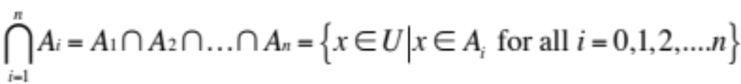
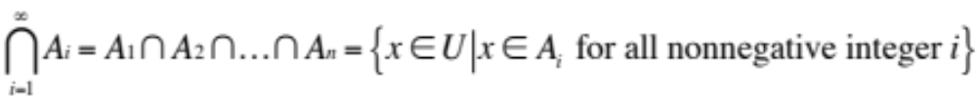
Generalized Unions and Intersections
(cont’d)
The intersection of a collection of sets is the set that contains those elements that are members of all the sets in the collection.
Notation:

Slide 39

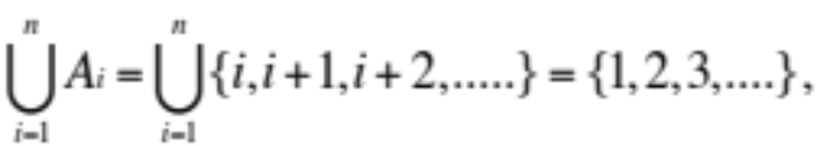
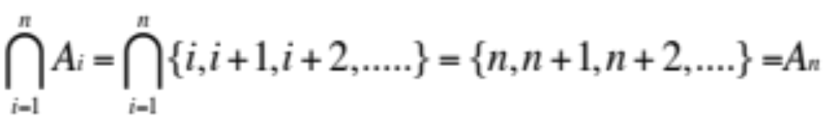
Example
For i = 1, 2, ……, let
and

Slide 40
Cartesian Product
Let A and B be sets.
An ordered pair of elements a∈A dan b∈B written (a, b) is a listing of the elements a and b in a specific order.
The ordered pair (a, b) specifies that a is the first element and b is the second element.

Slide 41
Cartesian Product
An ordered pair (a, b) is considered distinct from ordered pair (b, a), unless a=b.
Example (1, 2) ≠ (2, 1)

Slide 42
Cartesian Product
The Cartesian product of two sets A and B, written A×B is the set,
A×B = {(a,b)| a∈A, b∈B}
For any set A,
A×∅ = ∅×A = ∅

Slide 43
Example
A= {a, b}, B={1, 2}.
A×B = {(a, 1), (a, 2), (b, 1), (b, 2)}
B×A = {(1, a), (1, b), (2, a), (2, b)}

Slide 44
Cartesian Product
if A ≠ B, then A×B ≠ B×A.
if |A| = m and |B| = n, then |A×B|=mn.

Slide 45
Example
A= {1, 3}, B={2, 4, 6}.
A×B = {(1, 2), (1, 4), (1, 6), (3, 2), (3, 4), (3, 6)}
B×A = {(2, 1), (2, 3), (4, 1), (4, 3), (6, 1), (6, 3)}
A ≠ B, A×B ≠ B×A
|A| = 2 , |B| = 3, | A×B |= 2.3= 6.

Slide 46
Cartesian Product
The Cartesian product of sets A₁, A₂, …., A_{n} is defined to be the set of all n-tuples
(a₁, a₂,…a_{n}) where a_{i}∈A_{i} for i=1,…,n;
It is denoted A₁ × A₂ × …. × A_{n}
|A₁ × A₂ × …. × A_{n} |= |A₁ |.|A₂ | …. |A_{n} |

Slide 47
Example
A= {a, b}, B={1, 2}, C={x, y}
A×B×C = {(a,1,x),(a,1,y), (a,2,x), (a,2,y),
(b,1,x), (b,1,y), (b,2,x), (b,2,y)}
|A×B×C|= 2. 2. 2 = 8

Slide 48
Exercise
Let A= {w, x}, B={1, 2} and C={KB, SD, PS}.
  Find |A×B|, |B×C|, |A×C|,|A×B×C|,|B×C×A|, |A×B×A×C|
Determine the following set,
  A×B, B×C, A×C
  A×B×C
  B×C×A
  A×B×A×C

Slide 49
Exercise
Let X= {1,2}, Y={a} and Z={b,d}.
  List the elements of each set.
  X×Y
  Y×X
  X×Y×Z
  X×Y×Y
  X×X×X
  Y×X×Y×Z

